Slide 1
Checkbook NYC
AUGUST 28, 2013
Social Media Contribution

Slide 2
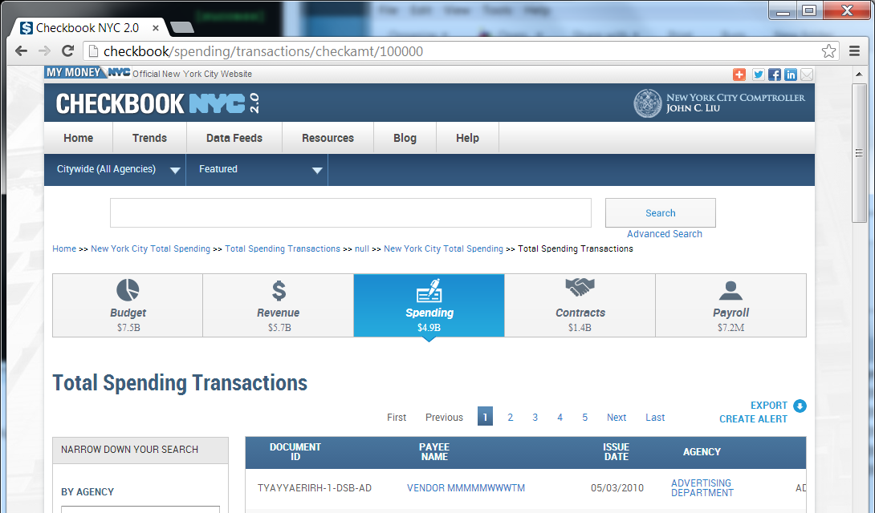
Email Alert – Step 1
After a user performs a Search or Advanced Search in Checkbook, a “Create Alert” link will appear at the top of the results section near the current “Export” link.

Slide 3
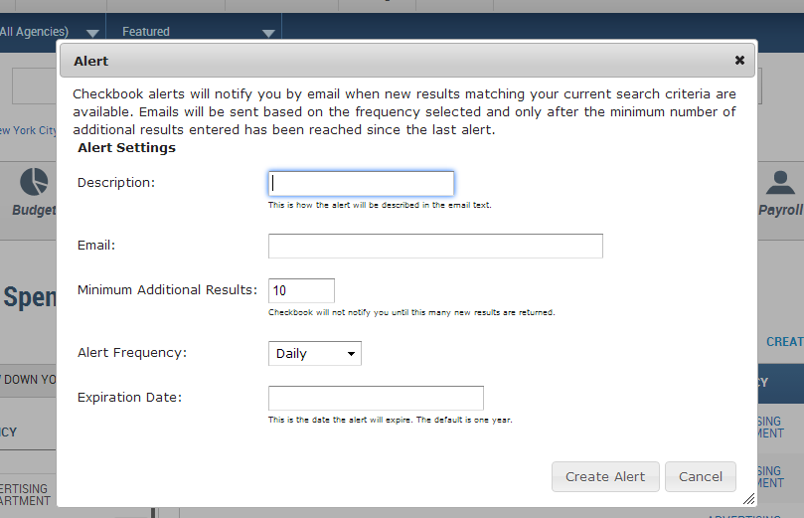
Email Alert – Step 2
After clicking the “Create Alert” link the Alert window appears for the user to define the alert parameters.

Slide 4
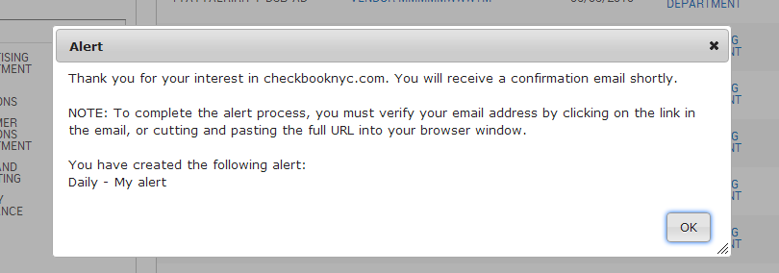
Email Alert – Step 3
After clicking the “Create Alert” button on the alert window and all fields pass validation, the following message is displayed to the user.

Slide 5
Email Alert – Step 4
The following is the template for the confirmation email that will be sent to the user.
Subject: Checkbooknyc.com alert confirmation
Body:
Thank you for creating an alert on checkbooknyc.com.
The following alert has been created and will be sent to your email address:
[insert Daily, Weekly, or Monthly] - [insert description entered by user]
To complete the process, please click on the following link:
[insert link to confirm subscription]
(If link above is not active, please cut and paste full URL into your browser window.)
PLEASE DO NOT REPLY TO THIS MESSAGE!

Slide 6
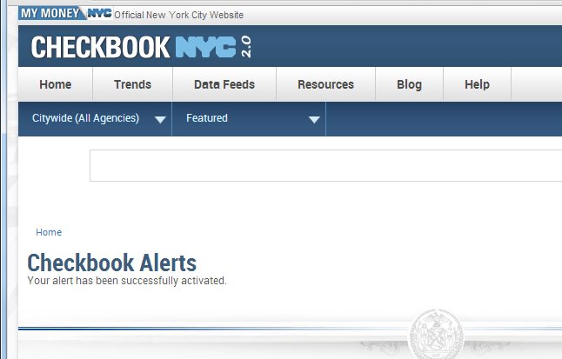
Email Alert – Step 5
The following is screen the user will see after clicking on the confirmation email link.

Slide 7
Email Alert – Step 6
The following is the template for the email of the actual alert.
Subject: Checkbook NYC alert
Body:
Below are the results of the triggered alert(s) from checkbooknyc.com:
Alert description : [insert alert description entered by user]
Alert frequency: [insert alert frequency entered by user]
Number of new records that match alert criteria: [insert count of new records that match alert]
Link to Checkbook NYC alert results: [insert URL that brings you back to search results]
To unsubscribe to this alert click here: [insert URL to unsubscribe from alert]
Alert description : [insert alert description entered by user]
Alert frequency: [insert alert frequency entered by user]
Number of new records that match alert criteria: [insert count of new records that match alert]
Link to Checkbook NYC alert results: [insert URL that brings you back to search results]
To unsubscribe to this alert click here: [insert URL to unsubscribe from alert]
…
To unsubscribe to all alerts sent to this email address click here: [insert URL to unsubscribe from all alerts]
Office of the Comptroller - City of New York

Slide 8
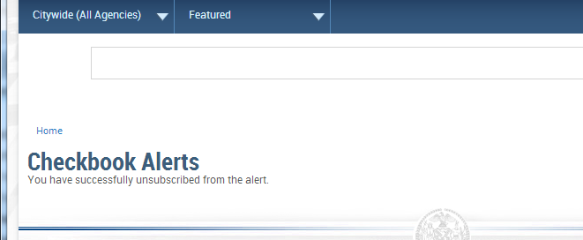
Email Alert – Step 7
The following is the screen a user will see if the follow any of the unsubscribe links in the alert email.

Slide 9
Twitter Alerts – Step 1
Since Twitter alerts will be created by the system admin, we have decided to allow the alert to be as
flexible as possible. The twitter alert uses the advanced search logic to build a query that returns a count that
can be inserted into a tweet. The twitter account information is stored in the table. Detailed directions on how
to create a twitter alert will be provided.
A Twitter alert can have a description of up to 100 characters long. It is shorter than the 144 allowed for a
tweet to leave room for the link we will need to post.
A variable defined as [[count]] has been created and should be used in the description where you would like
the number of new records that match the alert criteria to be substituted. The link to the results of the alerts is
always appended to the end of the description.
For example, let’s say we wanted to create a Twitter alert with a frequency of daily that looked at the number
of contracts with a value over 10 million dollars. The following could be one possible description:
Yesterday [[count]] new contracts over $10,000,000 were added to Checkbook NYC. Check it out!
Assuming 5 new records were added to Checkbook the following would be the resulting tweet:
Yesterday 5 new contracts over $10,000,000 were added to Checkbook NYC. Check it out!
http://checkbooknyc.com/...

Slide 10
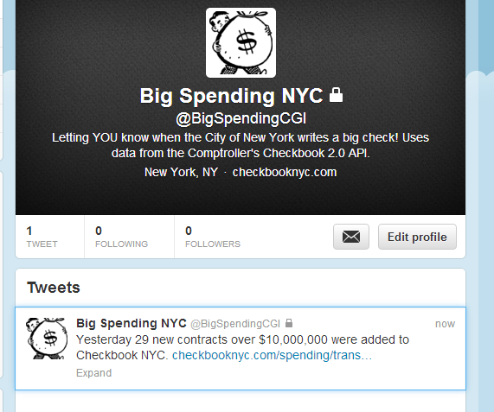
Twitter Alerts – Step 2
The following is an example of a tweet alert.

